Slide 1
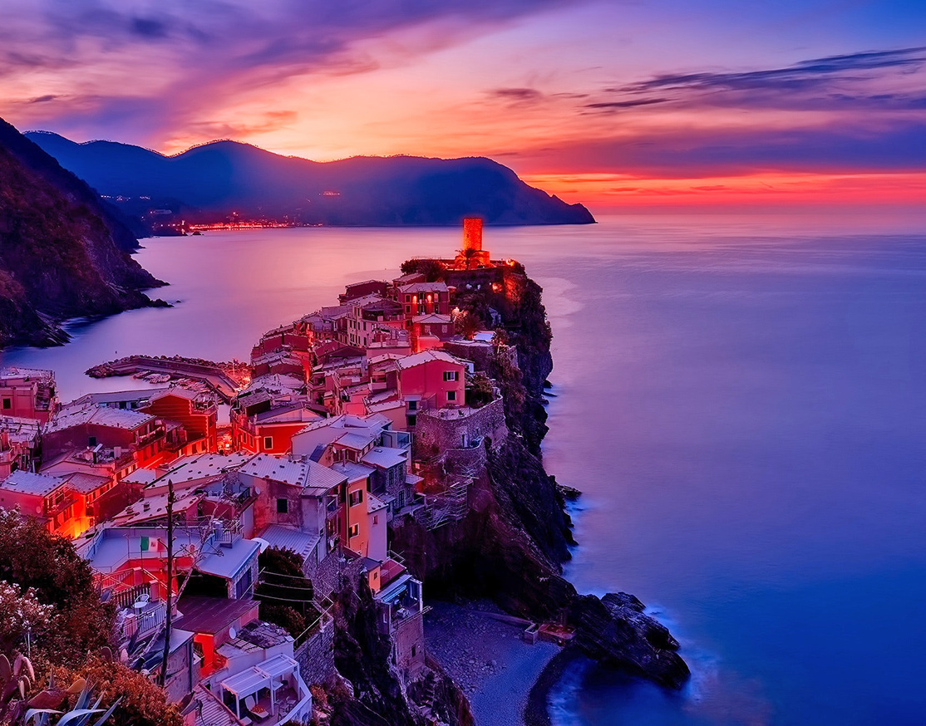
VISIT INDIA TOURISM
Guide By:-
ASHISH SHUKLA SIR

Slide 2
CONTENT:
INTRODUCTION
DESTINATION OF INDIA
DATA FLOW DIAGRAM
MODULES OF PROJECT
PROJECTS SCREENSHOTS
FUTURE SCOPE
CONCLUSION

Slide 3
INTRODUCTION:
Tourism is the growing industry.
It create job opportunity.
It enhances the income sources.
It strengthen the nations economy.
Considered as major contributor in economy of nation.
Some countries highly depended over tourism.
Country of rich heritage and traditions having a vast and varied history.
Government render adequate level of support for the enhancement of tourism sector.

Slide 4
DESTINATION OF INDIA :
There are various interesting places in India where you can spend your vacations.
Some world famous destinations of India such as:
Delhi
Mussoorie
Goa
Kerela
Jaipur

Slide 5
DESTINATION OF INDIA :
Manali
Amritsar
Darjeeling
Tamil Nadu
You will definitely enjoy your valuable vacations here and create an unforgettable memories for the future.
You can spend your vacations in this exotic and unusual places with your family or friends.

Slide 6
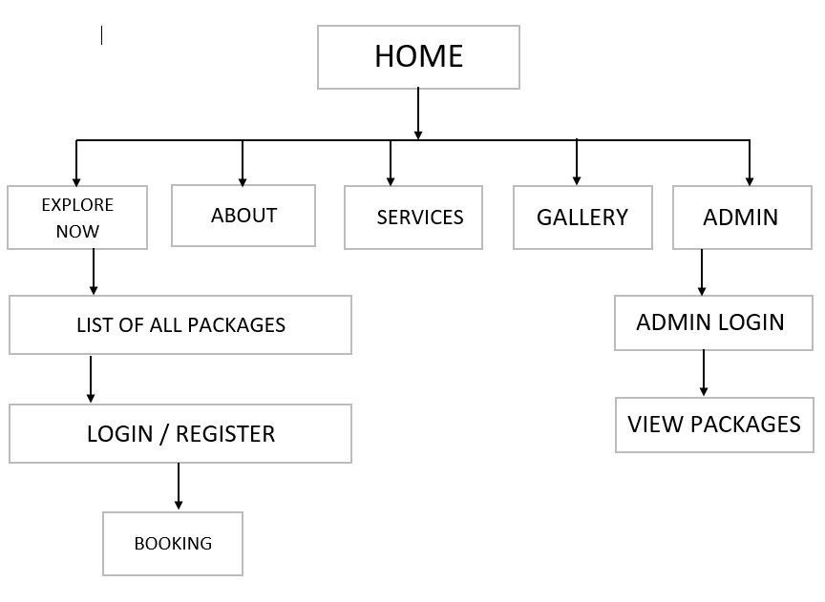
DATA FLOW DIAGRAM:

Slide 7
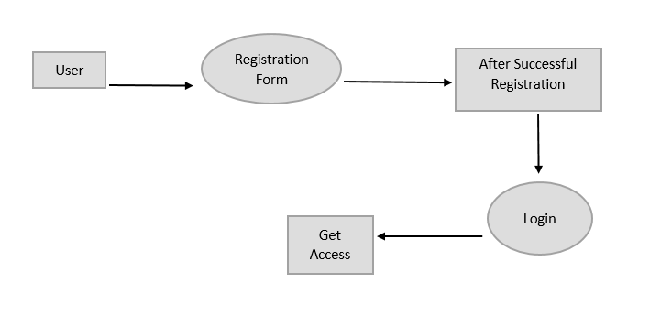
module :

Slide 8
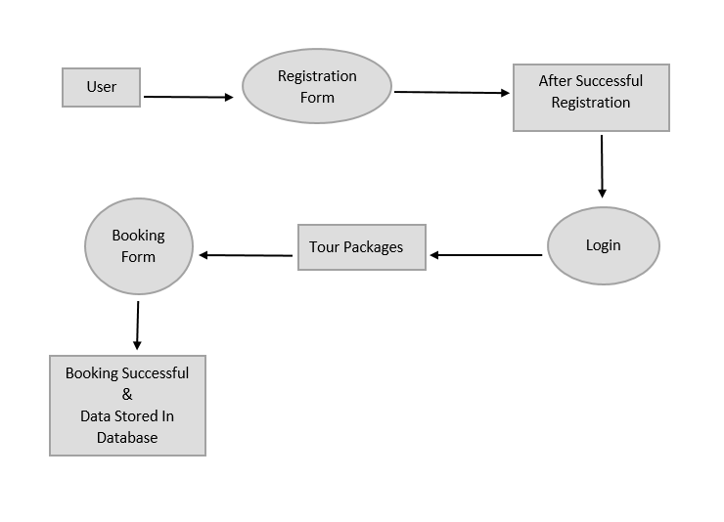
module :

Slide 9

MODULES OF PROJECT:
Customer:
REGISTER
VIEW PAKAGES
BOOKING

Slide 10
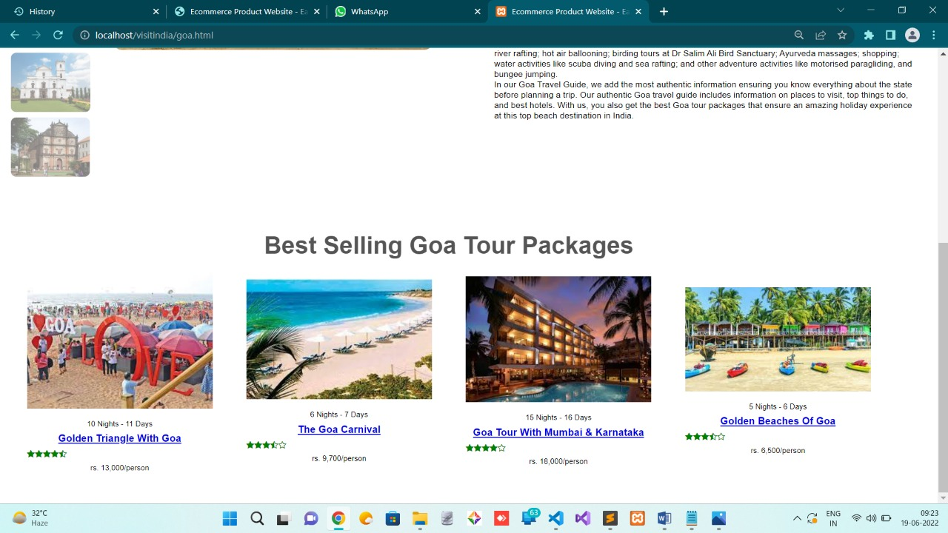
ADMIN:
LOGIN
VIEW BOOKING

Slide 11
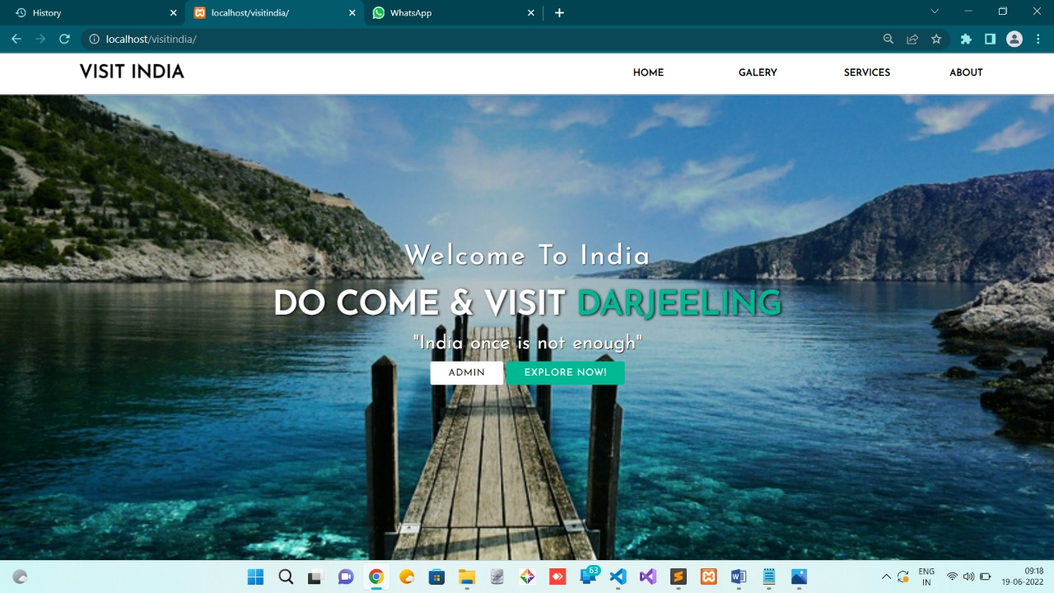
PROJECT Home page:

Slide 12
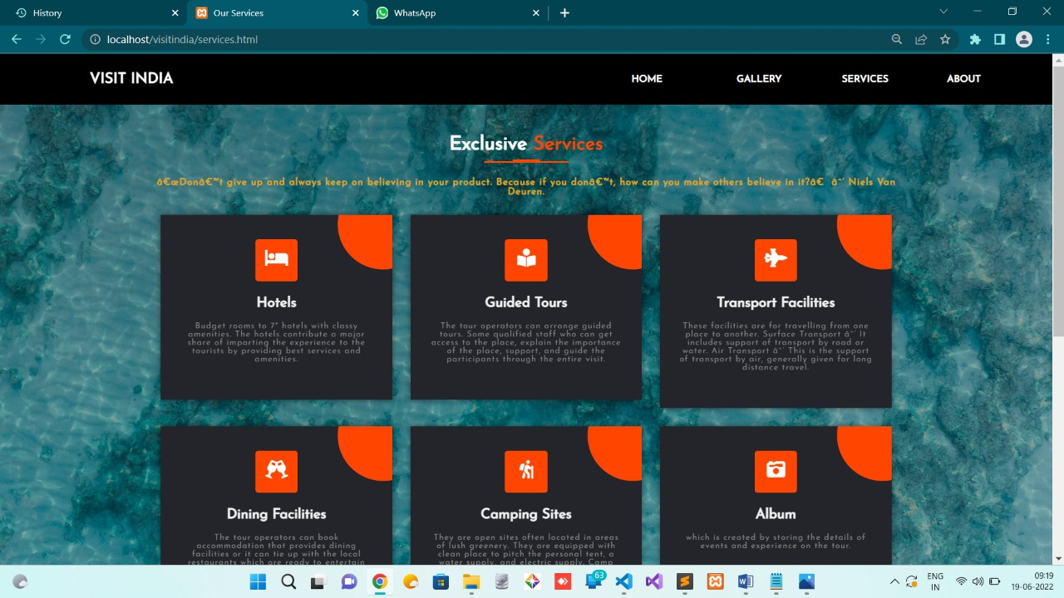
PROJECT Services page:

Slide 13
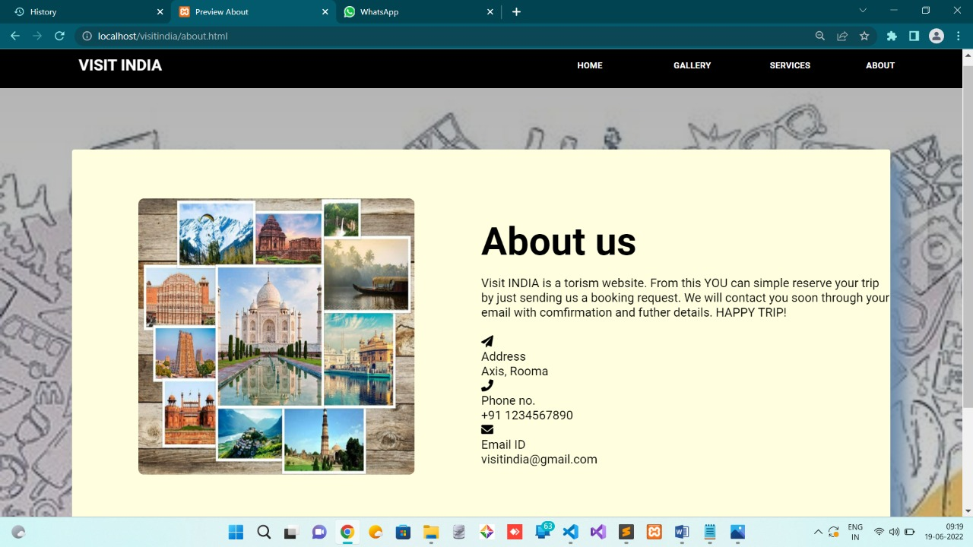
PROJECT about page:

Slide 14
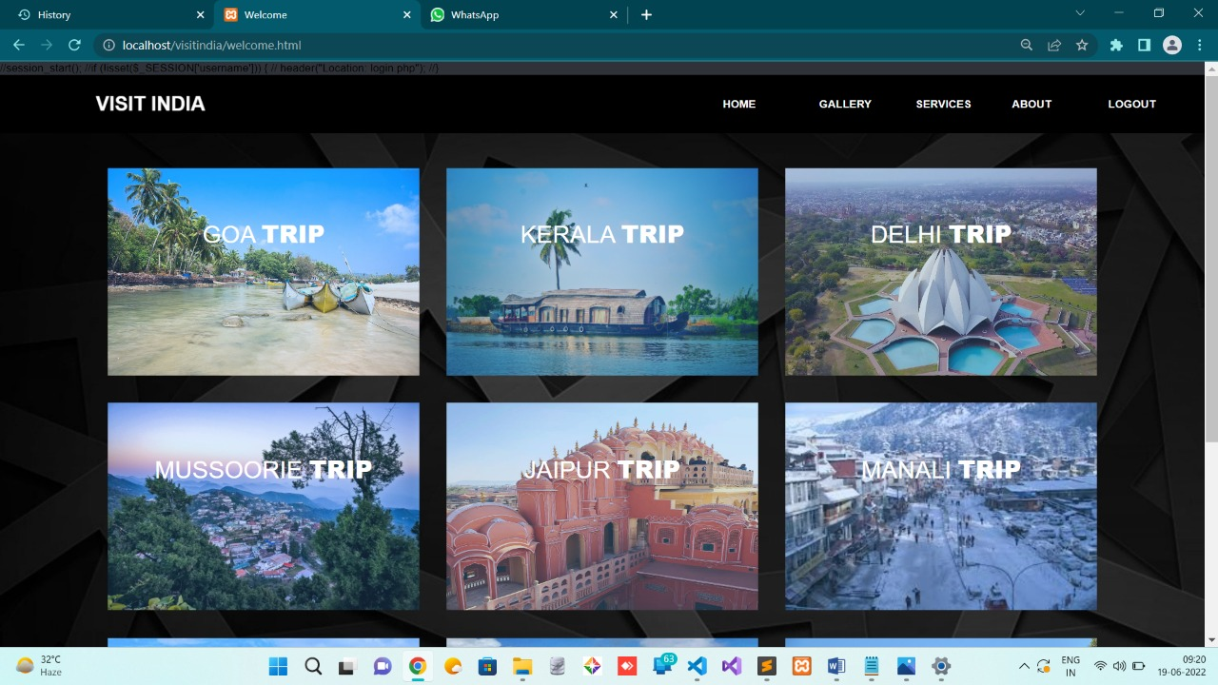
PROJECT trips page:

Slide 15
User goa trip page:

Slide 16
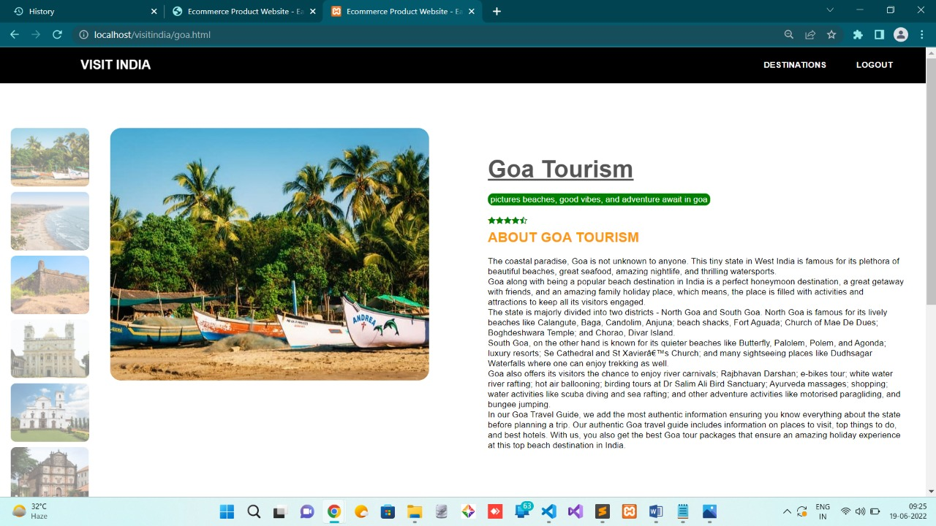
PROJECT goa trip page:

Slide 17
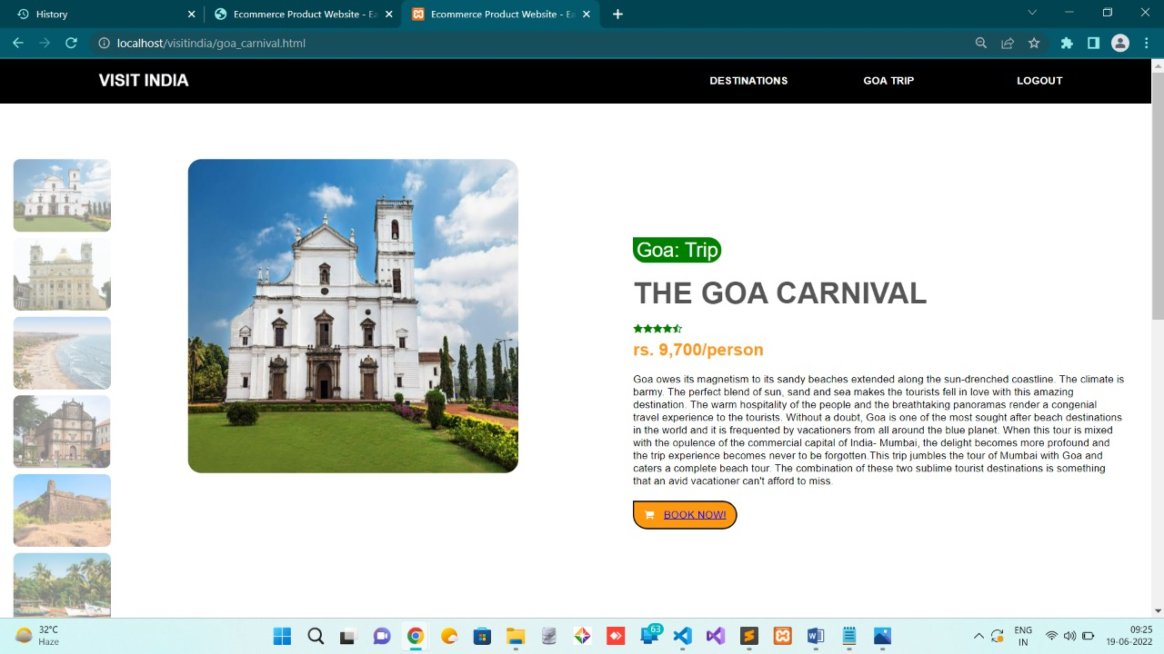
PROJECT goa trip page:

Slide 18
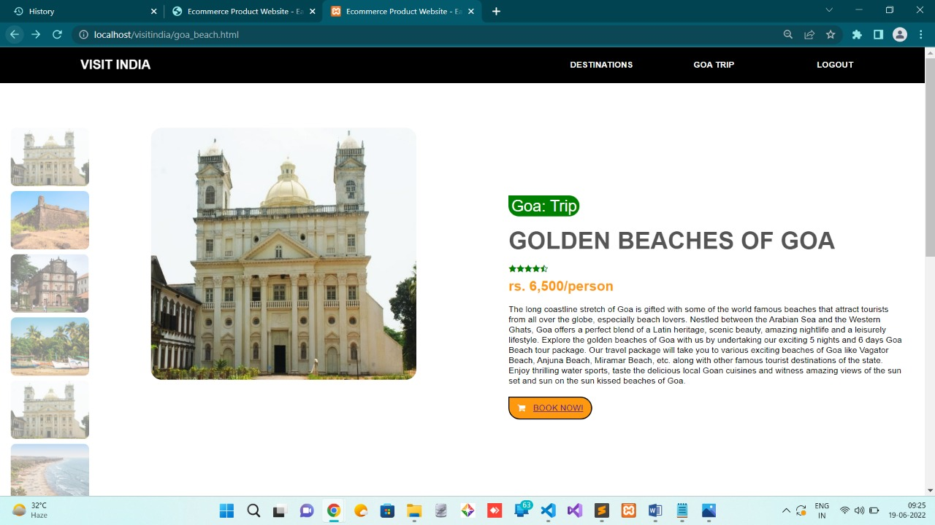
PROJECT goa trip page:

Slide 19
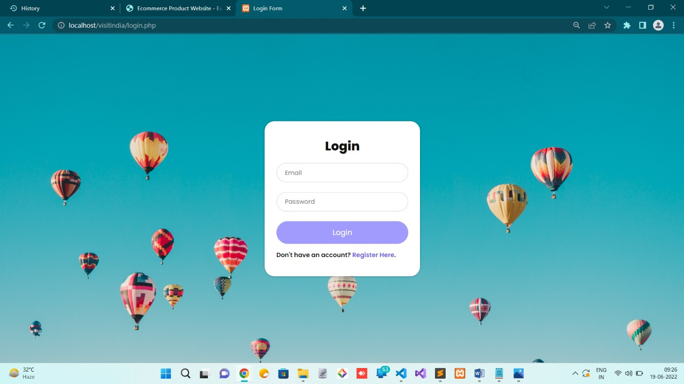
User login page:

Slide 20
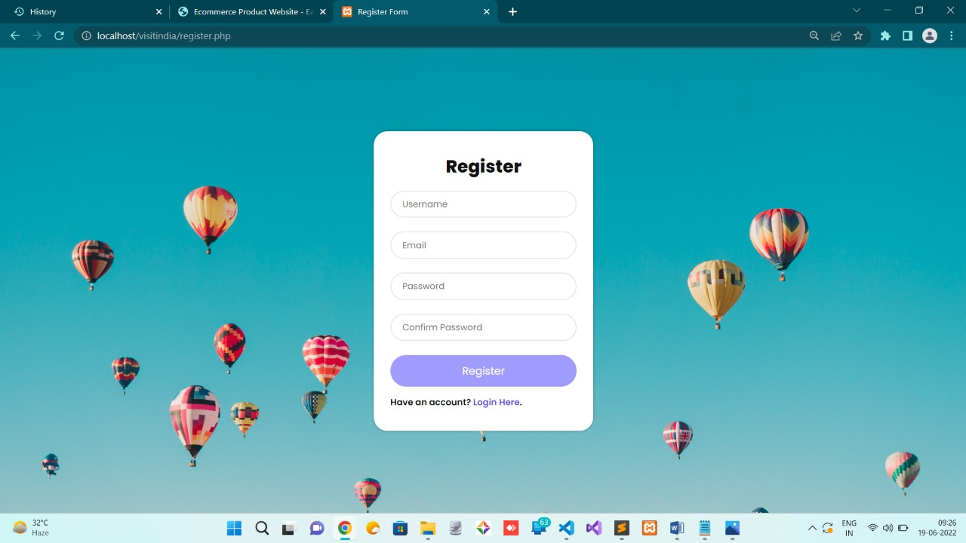
User register page:

Slide 21
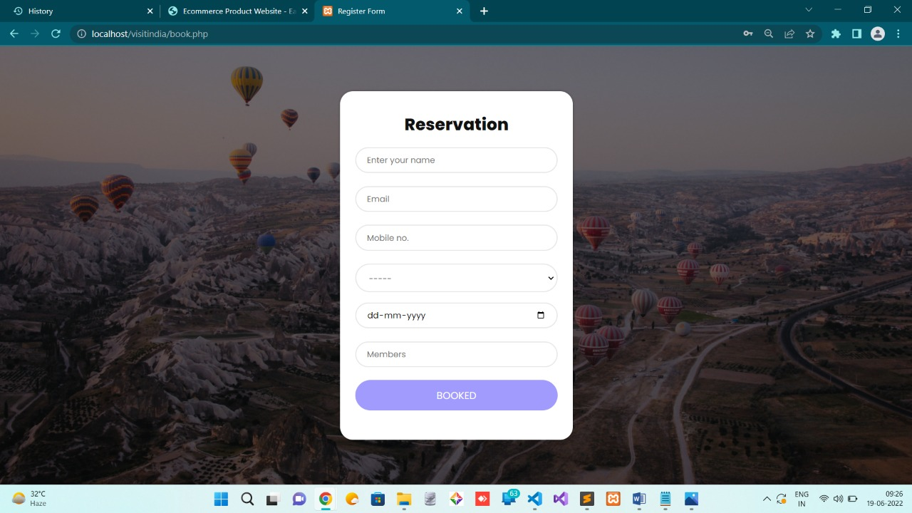
User booking page:

Slide 22
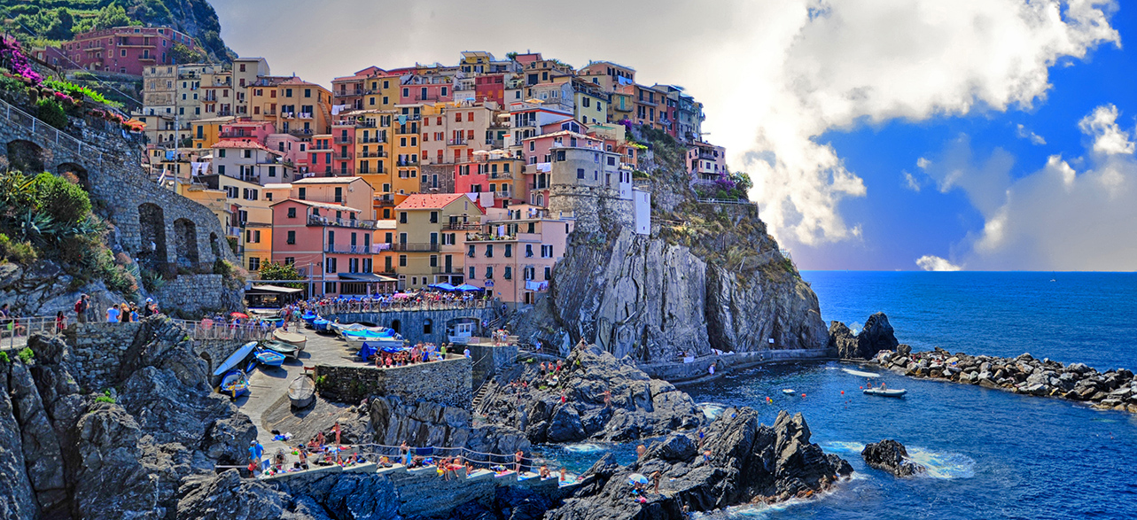
ADVENTURES TOUR

Slide 23
FUTURE SCOPE:
We will include more functionality as per the user requirements.
We want to improved our home page ,as it is the main thing which attracts all user.
Not a single website is ever consider as complete forever firstly because there is always something new requirements also are growing day by day.

Slide 24
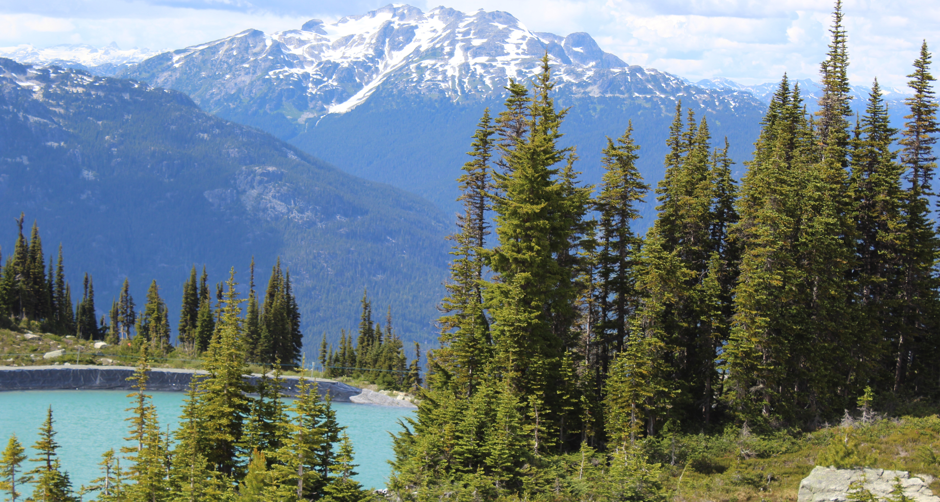
CONCLUSION:
The main focus of celebrating India National Tourists day is to educate people about the benefits of travelling and the importance of tourism .India is a tourist’s paradise and this trade plays an important role in the economy of the country.
Tourism sector is not only a major contributor to growth of economy but a generator of employments opportunities as well .Various initiative have also been taken by the Tourism Ministry of various states and the private players to transform India into a lucrative tourist destination win the world .

Slide 25

THANK YOU!
By:-
Arpita Sengar (0201430)
Nausheen Fatima ( 2014650)
Deepak Kumar (0201436)

